Slide 1


Cloud Native Manchester
September 2026
6PM: Networking with food and drinks
7PM: Modernising Kubernetes access at Booking: A journey from SSO to OIDC - Milap Anwani
Break!
~8PM: AI-Powered client-go Upgrades with Usage-First Scanning - Sachin Sachdeva
~8:30PM: Lightning Talks
Sponsored by:

Slide 2
Please take your seats
Getting started in a few moments!
6PM: Networking with food and drinks
7PM: Modernising Kubernetes access at Booking: A journey from SSO to OIDC - Milap Anwani
Break!
~8PM: AI-Powered client-go Upgrades with Usage-First Scanning - Sachin Sachdeva
~8:30PM: Lightning Talks

Slide 3
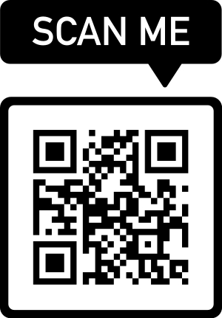
Announcements
Official CNCF meetup now, please “mark attendance” there:
https://community.cncf.io/cloud-native-manchester/
Future Manchester events:
Meetup on 19th November @ Morson-Edge Bonded Warehouse
Christmas Social on 3rd December @ Steelfish Brewery
Sponsors and talks always needed so please reach out via contact@cloudnativemcr.co.uk or https://sessionize.com/manchester-cloud-native-meetup/
Cloud Native Slack #manchester channel @ https://cloud-native.slack.com/archives/CJA8M2HCJ
Notes:
Christmas Social with Manchester Java Community

Slide 4
Lightning Talks
If anyone wishes to share a short lightning talk tonight or at a future event:
Please let an organiser know
Drop an email before a meetup to contact@cloudnativemcr.co.uk

Slide 5
Sponsor: Morson Edge
morson-edge.com
Thank you for hosting us this evening at Bonded Warehouse once again.
Notes:
Lloyd Lowson

Slide 6
Sponsor: Valarian
valarian.com
Thank you to Valarian for kindly sponsoring today's food.
Notes:
Matt Noble

Slide 7
Agenda
6PM: Networking with food and drinks
7PM: Modernising Kubernetes access at Booking: A journey from SSO to OIDC - Milap Anwani
Break!
~8PM: AI-Powered client-go Upgrades with Usage-First Scanning - Sachin Sachdeva
~8:30PM: Lightning Talks!

Slide 8
Modernising Kubernetes access at Booking: A journey from SSO to OIDC
Milap Anwani

Slide 9
Second talk starting at 7:50PM
Cloud Native Manchester Sponsored by

Slide 10
Please take your seats
Getting started in a few moments!

Slide 11
AI-Powered client-go Upgrades with Usage-First Scanning
Sachin Sachdeva

Slide 12
Quick Break
Cloud Native Manchester Sponsored by

Slide 13
Please take your seats
Getting started in a few moments!

Slide 14
Lightning Talks

Slide 15
See you next time
Lightning talks: come find us in person or register via email
Sponsors and longer talks always needed so please reach out:
contact@cloudnativemcr.co.uk
OR https://sessionize.com/manchester-cloud-native-meetup/
Please register on the CNCF site: https://community.cncf.io/cloud-native-manchester/
CNCF Slack: https://cloud-native.slack.com/archives/CJA8M2HCJ
Next Manchester meetup: 19th November @ Morson-Edge Bonded Warehouse

